Slide 1
- Pattern Recognition Term Project -
Pedestrian Detection by Using
Faster R-CNN Architectual
Team 13
2016010516 Jo Hyunjun
2017020600 Choi Wonseok
2016021306 Kim Byungdo

Slide 2
0. Table of contents
An overview of our project
Introduction of Faster R-CNN
Implementation of Faster R-CNN
Training the architecture and result

Slide 3
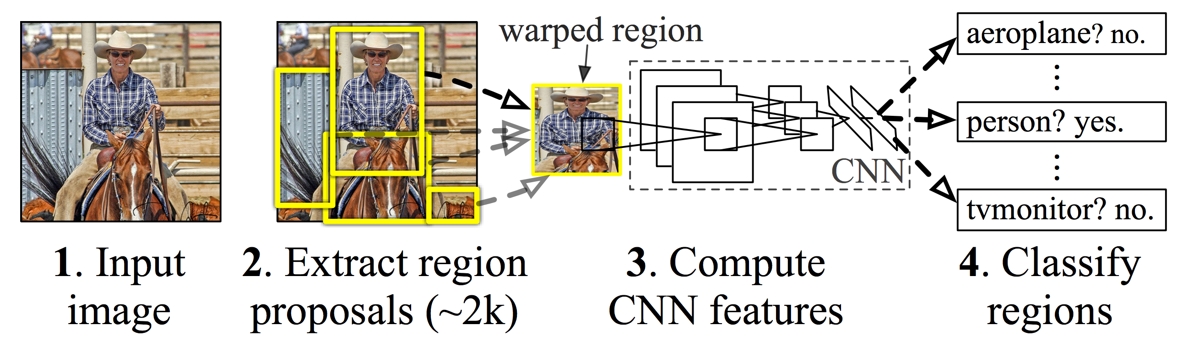
1. An overview of our project
Pedestrian detection
Goal
- Experiencing an implementation of deep learning architecture
Motivation
- Faster R-CNN is one of the most popular architecture for object detection
Method
- Implementation of Faster R-CNN architecture with tensorflow
- Training and testing Faster R-CNN with INRIA person dataset
< A basic concept of R-CNN >

Slide 4
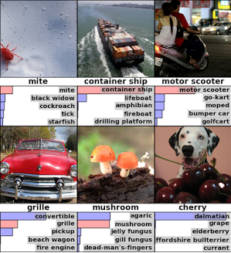
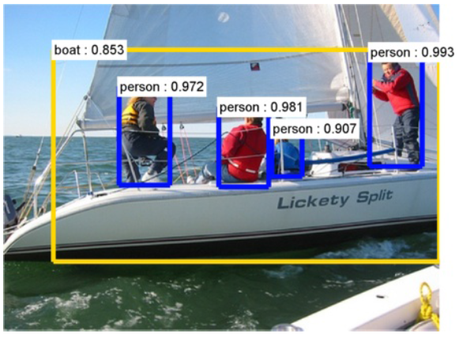
2. Introduction of Faster R-CNN(1/4)
Object classification
Discerning the class of objects in given images
Deep learning based object classification algorithm
- AlexNet (Alex Krizhevsky, 2012)
- VGGNet (Karen Simonyan, 2014)
- ResNet (Kaiming He, 2015)
- Etc.
Object detection
Detecting both the class and the position of objects in given images
Deep learning based object detection algorithm
- R-CNN (Ross Girshick, 2014)
- Fast R-CNN (Ross Girshick, 2015)
- YOLO(You Only Look Once) (Joseph Redmon, 2015)
- Faster R-CNN (Shaoqing Ren, 2016)
- Etc.

Slide 5
2. Introduction of Faster R-CNN(2/4)
Performance comparison between object detection algorithms
Accuracy of the Faster-RCNN is superior to others though slower than YOLO.
Other noticeable algorithms(late 2016 ~ up to now)
- YOLO9000 / YOLOv2 (Joseph Redmon, 2016)
- R-FCN (Jifeng Dai, 2016)
- SSD (Wei Liu, 2016)
- PVANET (Kye-Hyeon Kim, 2016)
Algorithm | R-CNN | Fast R-CNN | Faster R-CNN | YOLO
mAP (%) on VOC 2007 | 58.5 | 66.9 | 73.2 | 63.4
Test time (sec/img) | 50 | 2 | 0.2 | 0.02
*Data from the related papers

Slide 6
2. Introduction of Faster R-CNN(3/4)
Faster R-CNN
How it works
- Using ZF-Net, VGGNet, or ResNet as object classification algorithm
- Using RPN(Region Proposal Network)
- Proposed region is cropped by RoI-pooling, being fed as inputs to image classifier.
Features
- Holistic GPU computation is viable via usage of RPN.
- Sharing the CNN architecture to extract the feature map
→ Faster computation

Slide 7
2. Introduction of Faster R-CNN(4/4)
Classifier
While being similar to VGGNet, it outputs two pieces of information.
- Softmax is used as the classification layer.
- Bounding box regressor calibrates the size of bounding box.
Performance and test time
- mAP tested on VOC 2007
- VGGNet: 73.2%, 0.2 sec/img
- ResNet: 76.4%, 0.4 sec/img

Slide 8
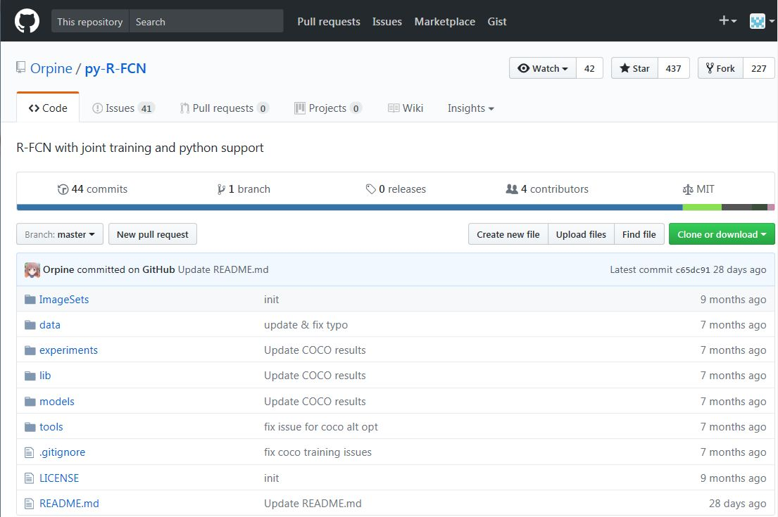





3. Implementation of Faster R-CNN
Computational resource
CPU : i7-6700, RAM : 64GB, GPU : Geforce GTX-1080 8GB
Construction of development environment
Python based environment
- Caffe, OpenCV 2.4.13, cuDNN 5.0, CUDA 8.0 library
Implementation of Faster R-CNN
Based on an opensource on Github(https://github.com/Orpine/py-R-FCN)
Modification needed to train the network with different dataset
< An opensource on Github >
< Building of development environment >

Slide 9
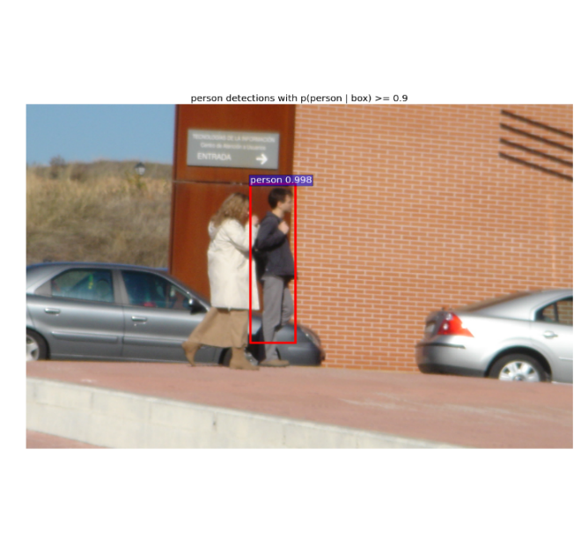
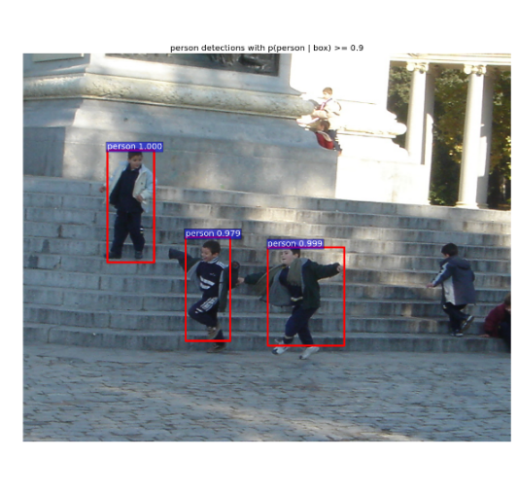
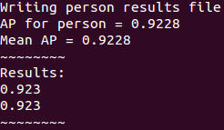
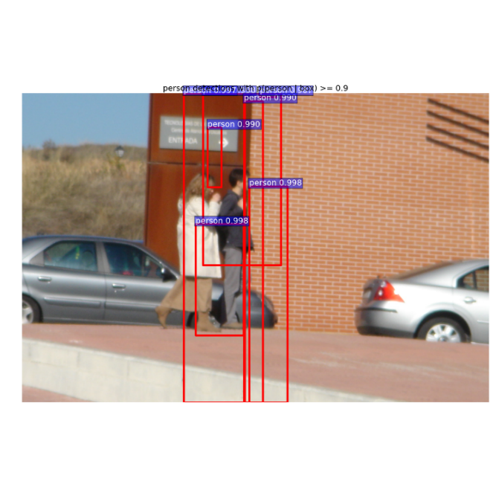
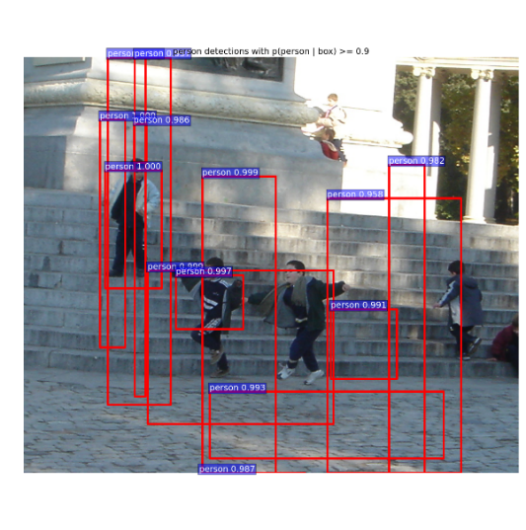
4. Training the architecture and result
Testing architecture
Using 600 images among INRIA person dataset
- Training 1 class(person) with 10,000 epoch
- mAP(Mean Average Precision) is about 92%
Getting better result with no bounding box regressor
< Bounding box regressor turned off >
< Mean Average Precision >
< Bounding box regressor turned on >

Slide 10
Thank you.

